Slide 1
Introduction to Graduate School
RISE UP @ Illinois
September 17, 2020
5:00 PM – 6:00 PM

Slide 2
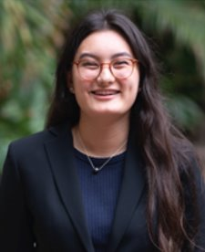
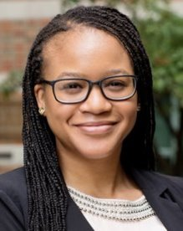
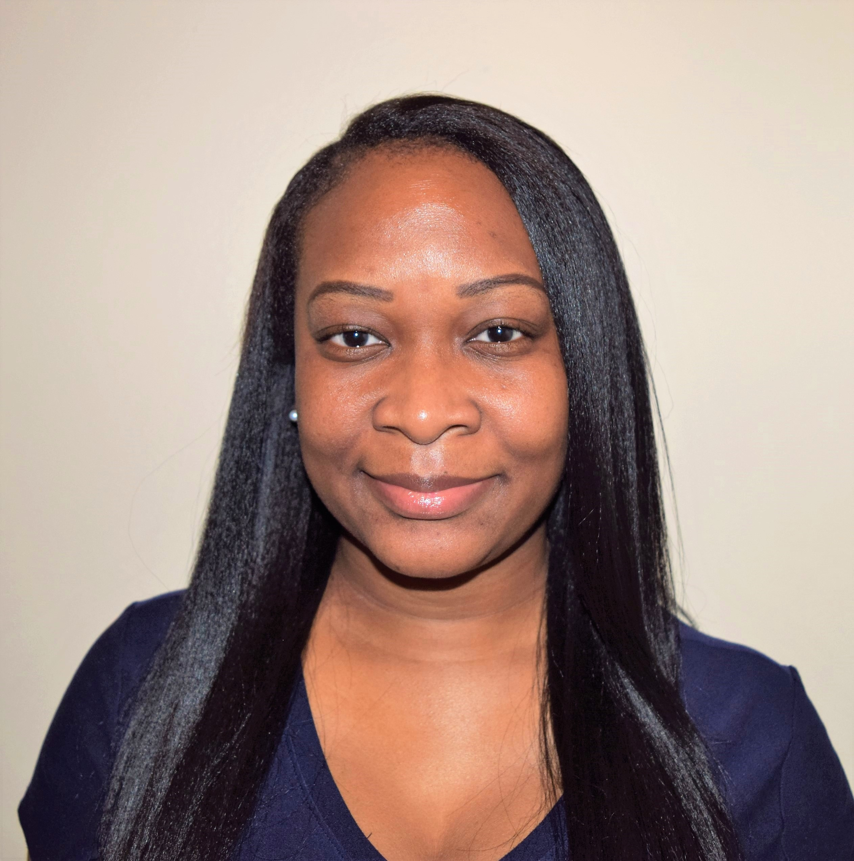
Introduction of panelists
Sasha Yamada
Electrical Engineering
2nd year PhD student
Mickeal Key
Neuroscience
6th Year PhD student
Dr. Ramisha Knight
Neuroscience
Postdoc
Notes:
Lonna
Notes
Sasha: Sasha Yamada is a PhD student and NSF Graduate Research Fellow in the Department of Electrical and Computer Engineering at the University of Illinois. Outside of her research, she enjoys working with the other members of the GEDI executive board. She was named Student Engineer of the Year by the Hawaii Council of Engineering Societies, an award given to one student in the state per year, and was also a Regents Scholar at the University of Hawaii.
Mickeal: Mickeal is a 6th year graduate student in the Neuroscience Program here at UIUC. She has a Master’s in Experimental Psychology, a BA in Psychology, and a BS in Molecular & Cellular Biology. She was a 2015 Summer Pre-Doctoral Institute Fellow, a 2015-2018 Illinois Distinguished Fellow, and a 2019 Beckman Institute Graduate Fellow. Her research focuses on how lifestyle factors such as diet affect the brain as we age. She is also interested in health disparities in cognitive aging.
Mickeal is involved with multiple organizations on campus including GEDI and the Neuroscience Student Organization. She also works with IDEA and the Office of Minority Student Affairs on projects aimed at supporting student success and improving retention for underrepresented students on campus.
Misha recently completed a postdoctoral research fellowship in cognitive neuroscience at the Beckman Institute for Advanced Science and Technology. She earned a PhD in Experimental Psychology from the University of Verona in Italy, where she researched how the human brain processes visual information. In addition to her doctorate, she has a BA in Psychology from Hawaii Pacific University and a MS in Cognitive Neuroscience from the University of Durham in England.

Slide 3
Why go to graduate school?
What are your career goals? Will a graduate degree help you achieve them?
How much will your paygrade increase with a graduate degree?
This will vary by field
What degree program are you interested in? Consider that:
You will likely have to pay for professional master’s programs out of pocket
Most STEM PhD and MS programs are funded through TA/RA-ships
Notes:
Sasha

Slide 4
The application process
Look for programs
MS or PhD?
Identify concentration area
Prepare application
GRE
Personal statement
Recommendation letters
Submit applications
Most deadlines in mid-Dec.
Admission decisions
Talk to potential advisors and their students
Attend visit weekends
Consider applying to fellowships
Submit applications
Deadlines range from Sep.-Dec.
Decide!
Notes:
Sasha

Slide 5
Fellowships– overview
 | Degree program | Class standing during application | Citizenship | 🥖💸 | Additional comments
NSF GRFP | STEM MS/PhD | UG senior, 1st-2nd year GRAD | US citizen, national, or perm resident | $34k/year + tuition coverage, for 3 years | Underrepresented students encouraged to apply
GEM | STEM MS/PhD | UG senior, GRAD | US citizen, national, or perm resident | $8k-$18k/year + tuition, for typical duration of program | For underrepresented students
NDSEG Fellowship | STEM PhD | UG senior, 1st-2nd year GRAD | US citizen or national | $38k/year + tuition coverage, for 3 years | --
DoD SMART | STEM MS/PhD | UG, GRAD | Citizen of US, AUS, CAN, NZ, or UK | $25k-38k year + tuition | Must be have interest in a career related to DoD
Ford Foundation | STEM PhD | UG senior, 1st-2nd year GRAD | US citizen, national, or perm resident | $27k/year, for 3 years | Must have commitment to a career in academia
Microsoft | STEM PhD | 3rd year GRAD | Enrolled in university in North America | $42k/year + tuition, for 2 years | Must be nominated by University
Notes:
Sasha

Slide 6
Fellowships– overview
 | Degree program | Class standing during application | Citizenship | 🥖💸 | Additional comments
Fulbright Scholars | Any | B.S./B.A. or higher | US citizen | Varies to cover stipend and travel expenses | Funds to conduct research or study abroad.
AAUW | MS/PhD | Depends, multiple fellowships offered | Opportunities for all citizenships | Awards vary between ~$5k-30k | For women
Smithsonian Institutional Fellowships | MS and Higher | Depends, multiple fellowships offered | Open to all. | Depends on experience level and duration of research appointment | offers opportunities conduct independent research using the resources of the Smithsonian Institution.
Hispanic Scholarship Fund | UG/MS/PhD | Depends, multiple fellowships offered | US citizen, national, perm resident, or DACA | Up to $5k | Must be of Hispanic heritage
Note: Additional Fellowships may be found through the U of I Fellowship Finder and The Office of External Fellowships can help review applications if contacted early.
Notes:
Sasha

Slide 7
Questions for panelists
Notes:
Jamie

Slide 8
What qualities should someone look for
in a graduate program?
Notes:
Jamie

Slide 9
Did you always know you would go to graduate school? What was the determining factor for pursuing a graduate degree?
Notes:
Jamie

Slide 10
How did your network develop while in graduate school? Has your new network given you new opportunities?
Notes:
Jamie

Slide 11
How does graduate school differ from
the undergraduate experience?
Notes:
Vongai

Slide 12
Did you need to change your perspective from undergrad to be successful in graduate research? If so, what changed?
Notes:
Vongai

Slide 13
What should I expect during a
graduate school interview?
Notes:
Vongai

Slide 14
Which of your skills and/or attributes have you focused on developing during graduate school?
Notes:
Vongai

Slide 15
In your experience, what is the dynamic between a graduate student and a professor conducting research together?
Notes:
Jaden or Lonna

Slide 16
In hindsight, is there anything you
would have done differently?
Notes:
Jaden or Lonna

Slide 17
Open questions
Notes:
Jaden or Lonna

Slide 18
Fall 2020 Book
Notes:
Lonna or Vongai

Slide 19
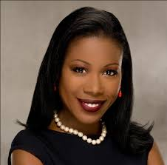
"Caste" by Isabel Wilkerson
The Pulitzer Prize–winning, bestselling author of The Warmth of Other Suns examines the unspoken caste system that has shaped America and shows how our lives today are still defined by a hierarchy of human divisions.
Make sure you join the Slack to keep up to date with book club!
Notes:
Lonna or Vongai

Slide 20
Thank you for attending!

