Slide 1
GEDI x NSBE Pilot Program
8/31/2020
Notes:
Jamie 1-4

Slide 2
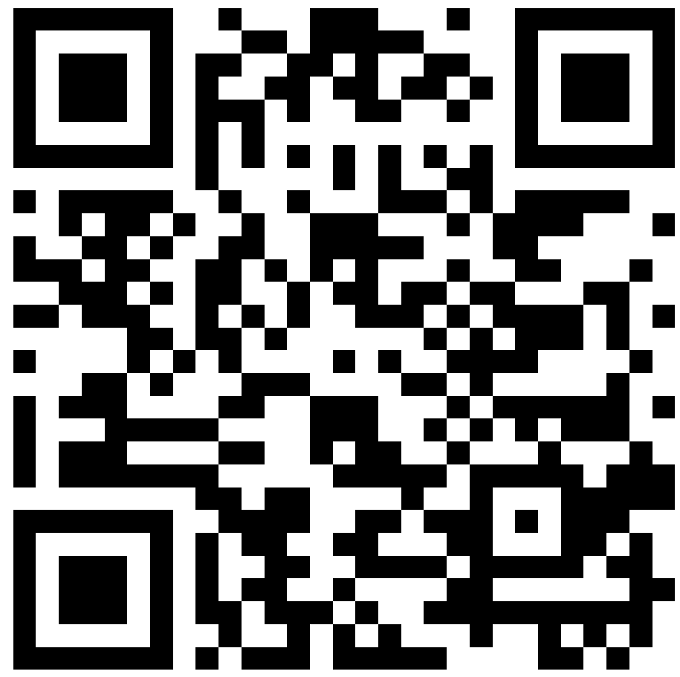
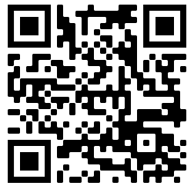
Sign-in using the QR or corresponding link.
https://bit.ly/34lP9ZX
https://bit.ly/2FFtodm
Use the following sign-in if you are not a part of the Grainger College of Engineering and/or do not have access to Grainger Student Portal (GSP)

Slide 3
Background
If you are able to, turn on your camera!

Slide 4
What is RISE UP @ Illinois?
Stands for 'Retention, Inclusion and Support Efforts for Underrepresented Persons at Illinois'
A collaboration between Graduate Engineers Diversifying Engineering (GEDI) and the National Society of Black Engineers (NSBE)
Centered around building a stronger support system for underrepresented minority (URM) undergraduate and graduate students in the Grainger College of Engineering (GCOE)
This work is funded by the Institute for Inclusion, Diversity, Equity, and Access in the Grainger College of Engineering, University of Illinois (Grant #: GIANT202007)
Throughout the program surveys will be conducted in order to gain a better understanding of the URM student experience at UIUC
Notes:
Jamie

Slide 5
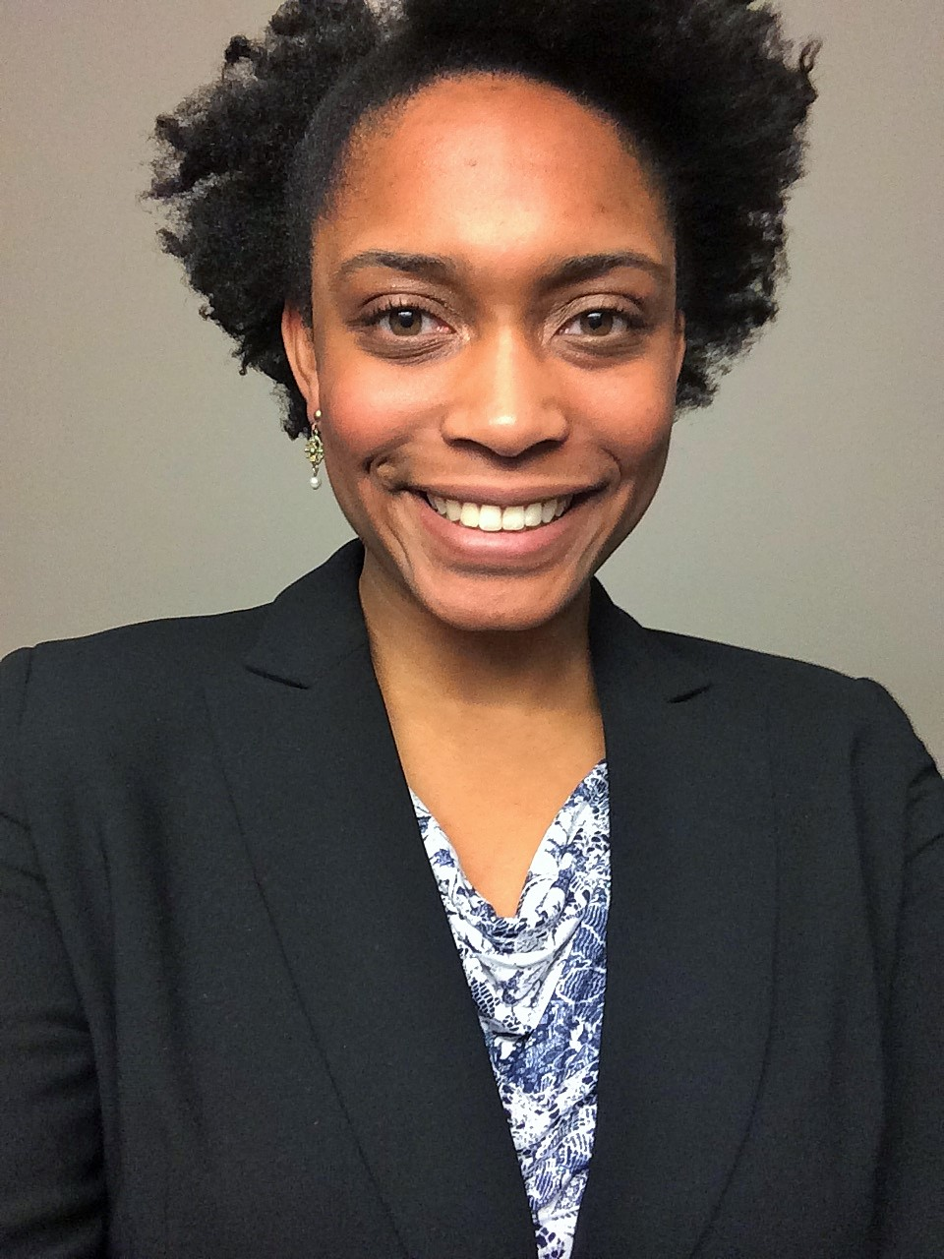
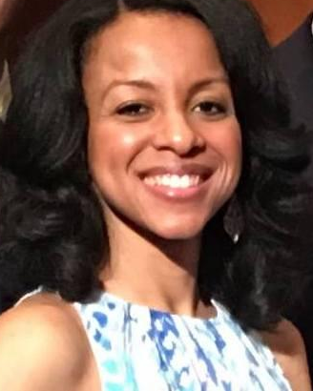
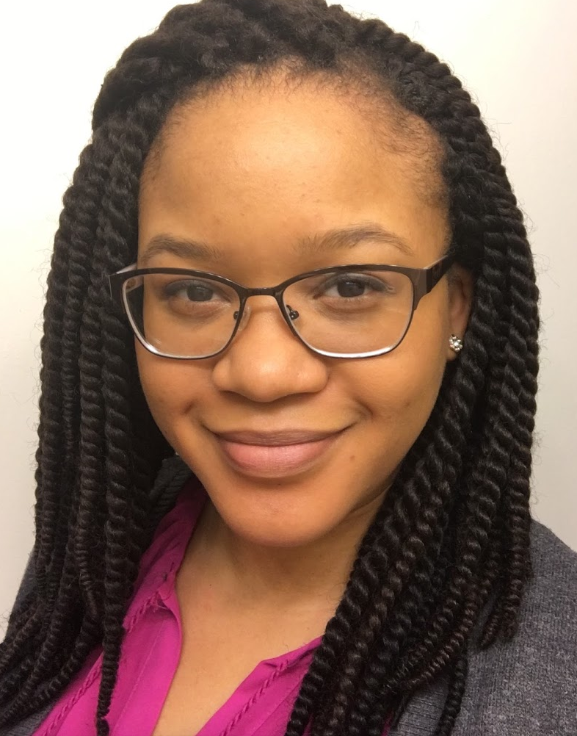
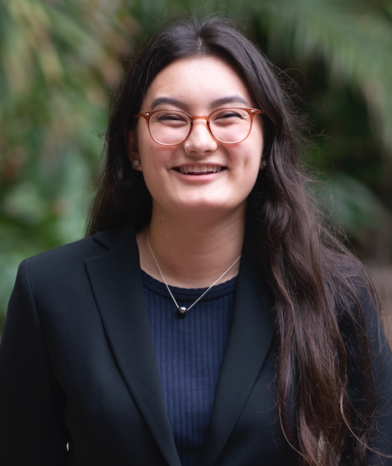
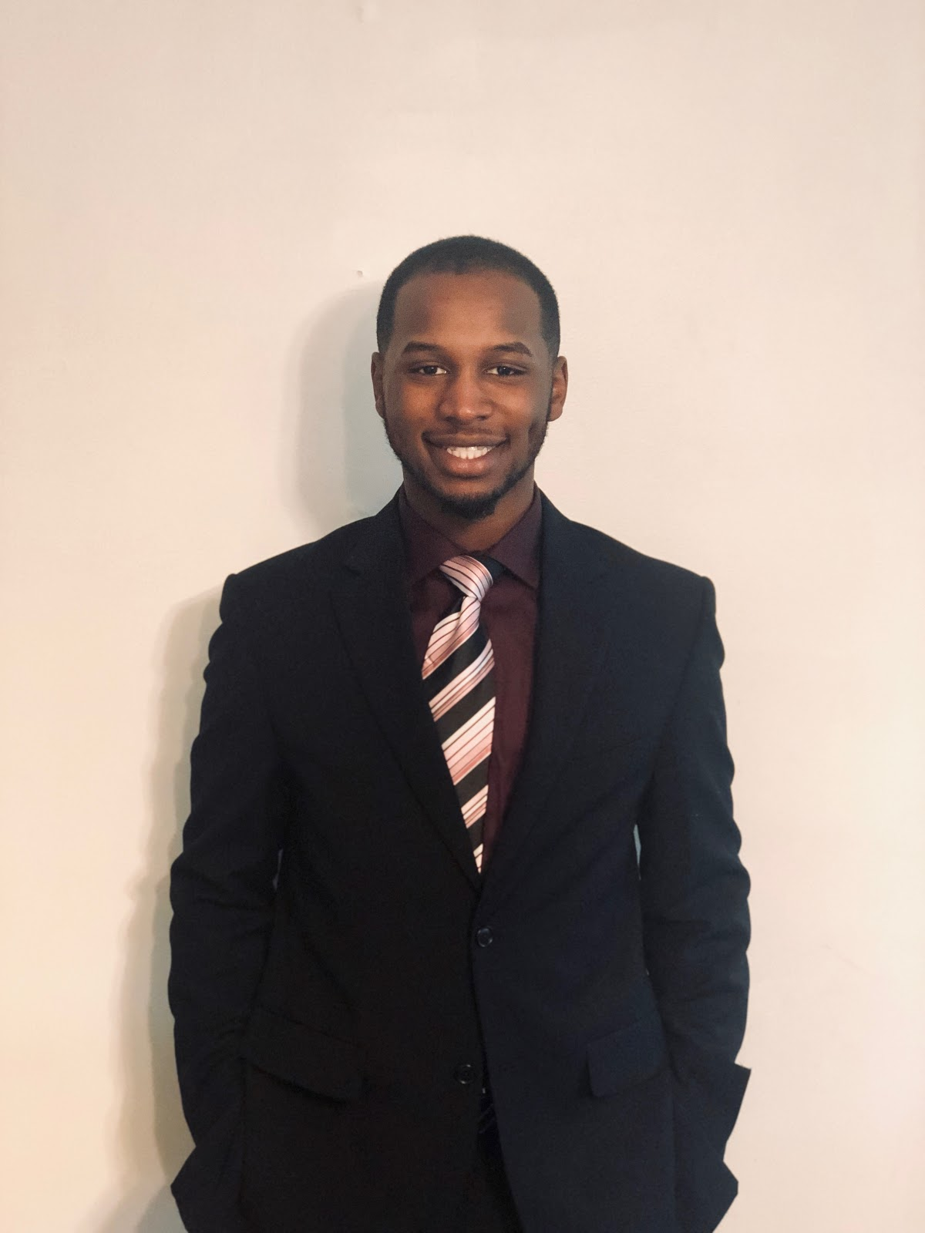
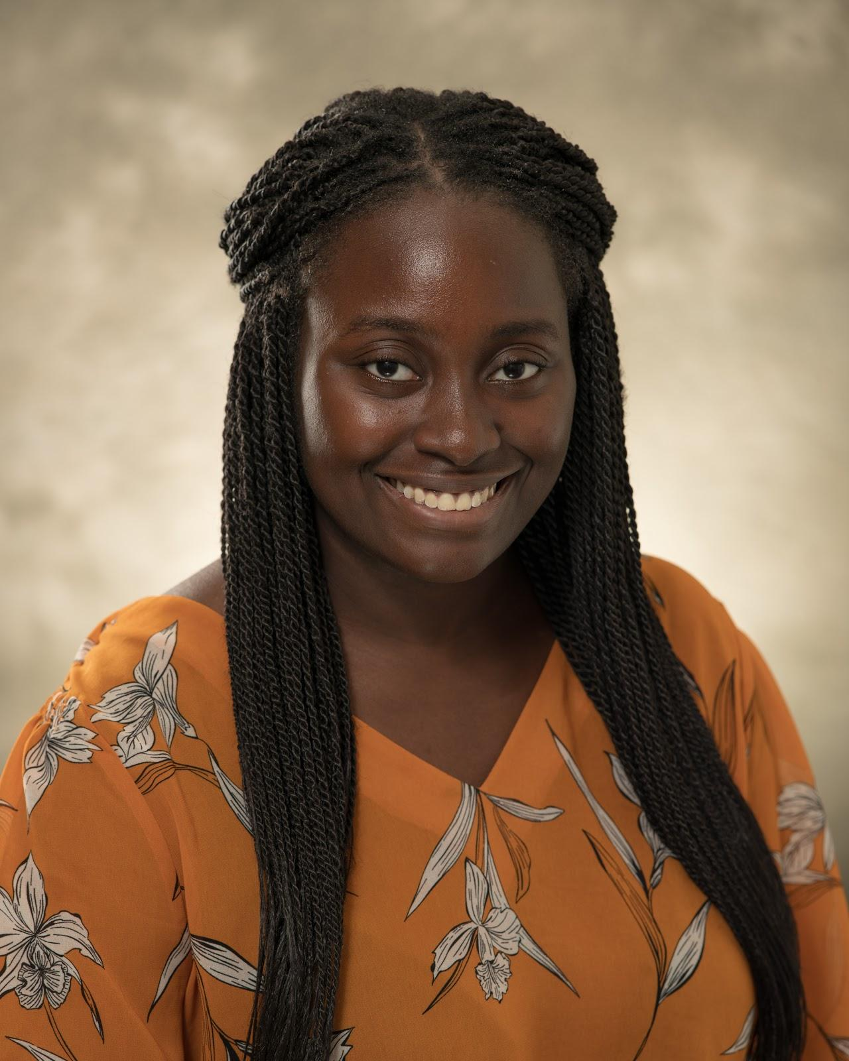
Introductions
Jamie V. Clark
jvclark3@illinois.edu
Lonna Edwards
ldedwar2@illinois.edu
Mickeal Key
mnkey2@illinois.edu
Sasha Yamada
sashasy2@illinois.edu
GEDI
Leadership
NSBE Leadership
Jaden Gladden
nsbe.uiuc.pres@gmail.com
Teagan Mathur
nsbe.uiuc@gmail.com
Vongai Tizora
nsbe.uiuc.vp@gmail.com
Notes:
Everyone introduces themselves: Name, Dept, Year (UG/Grad), Leadership position in NSBE or GEDI

Slide 6
Three-pronged approach
Build a mentorship network
Connect URM community with administrators
Educate broader U of I community
Notes:
Lonna 6-9

Slide 7
Three-pronged approach
Launching a mentorship program focused on pairing upperclassmen undergraduates with graduate students
Topics of interest include:
Research guidance
Goal setting/career planning
Problem solving
Social activities & networking
Academic success
Program will also connect students to faculty
Build a mentorship network

Slide 8
Three-pronged approach
Developing and maintaining relationships with U of I administrators willing to direct the concerns of URM students to the appropriate administrators
Purposeful surveys will be sent out to NSBE & GEDI membership to inquire on student experiences on campus and within the RISE UP @ Illinois Project
At the end of the year, leadership will meet, discuss specific concerns regarding campus climate for URM students, and compile a written report to initiate change
Connect URM community with administrators

Slide 9
Three-pronged approach
Hosting My Voice, My Story workshops for graduate students and faculty within the GCOE
This workshop, developed by Cornell University, focuses on teaching participants how to listen and develop an awareness and understanding of exclusion and inclusion in the learning and research environment
The faculty workshop scheduled for January 14, 2021. The date for graduate student workshop is still to be determined
Educate broader U of I community
Notes:
Separate audiences, same content
All can attend, but emphasize broader community

Slide 10
Programming for the 2020-2021 Academic Year
Tentative Plan
Notes:
Mickeal

Slide 11
Book Club
New book each semester
Highlighting authors of color
All participants will receive a free book & participate in scheduled discussions
Indicate if you want to participate in the book club on the interest form!
Notes:
Mickeal

Slide 12
Mentor Program
Year-long program
Upperclassmen undergraduates will be matched with graduate students and doctoral students
All participants will receive an embroidered notebook & participate in regularly scheduled check-ins
Indicate if you want to participate in the mentor program on the interest form!
Notes:
Vongai

Slide 13
Introduction to Graduate School
Learn about the benefits of pursuing a Master's Degree and/or Ph.D.
Discuss the application process and what to expect when applying
Chat with graduate students and postdocs as they share their experiences in academia
Thursday, September 17th from 5 pm – 6 pm
Notes:
Sasha

Slide 14
Additional Programs
Faculty Panel
STEAM Night
Happy Hour (Appetizers and Mocktails)
Chicago Trip
Mental Health Resources
Travel Award for Academic Conference
End of year social event
Notes:
Jaden

Slide 15
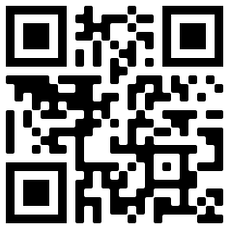
Expectations
RISE UP @ Illinois Program sign-up!​
Sign-up to join the RISE UP @ Illinois Program by Tuesday, September 8th
Occasionally participate in anonymous surveys through Redcap throughout the year
Participate in our programming, including optional semester long activities (e.g. book club)
https://bit.ly/31iQVJm
Notes:
Mickeal

Slide 16
Ice Breakers
We'll be splitting people up into breakout rooms. The prompts will be periodically displayed on the screen during this activity.
Notes:
Before breakouts Fast Intros: name, Grad/UG (year), fav food, call out next person (popcorn style)
Teagan – add slides 3-5 questions, padding.

Slide 17
Notes:
PREFERRED

Slide 19
Notes:
PREFERRED

Slide 20
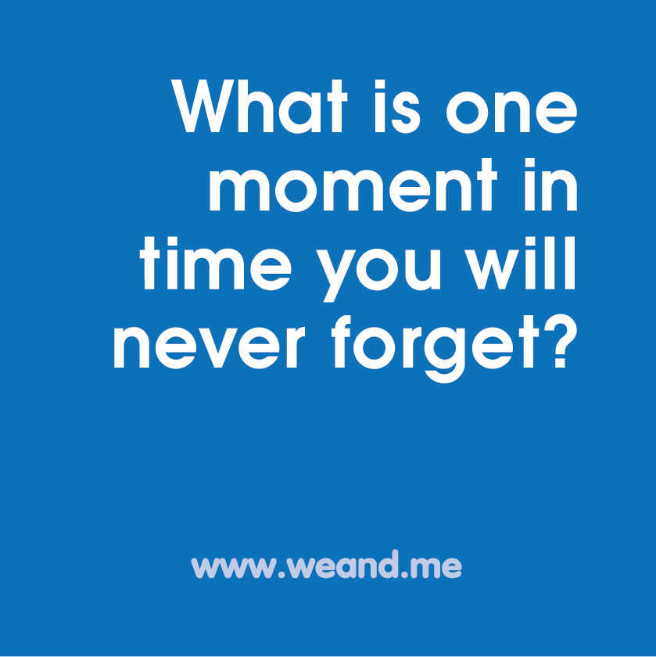

Slide 21
Notes:
PREFERRED

Slide 23
Questions?Thank you!

