Slide 1
Preparing for
Midterms w/ CARE
09-16-20

Slide 2
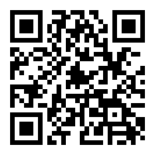
Sign-In
GSP Sign-In
Other Sign-In
https://forms.gle/cA6bazGoaKA7RtK99

Slide 3
The Mission of the National Society of Black Engineers is...
To increase the number of culturally responsible Black engineers who excel academically, succeed professionally, and positively impact the community

Slide 4
Check-in Time!

Slide 5
Weeks Before the Midterm...
This meeting will be recorded from this point on

Slide 6
Know when and where your exams are
Don’t let exams sneak up on you.

Slide 7
Know when and where your exams are
Know what you’re being tested on
Make sure you know what chapters the exam covers and what you do and do not need to study for.

Slide 8
Know when and where your exams are
Know what you’re being tested on
Study as you learn material
Get caught up on material that you don’t understand ASAP. Don’t wait to watch asynchronous lectures till the last minute!

Slide 9
The Day Before the Midterm...

Slide 10
Brush up on material briefly
Doing a quick review of your already reviewed notes will help you remember the most important concepts for the test.
Source: https://www.chegg.com/play/student-life/5-things-to-do-the-night-before-a-midterm/

Slide 11
Brush up on material briefly
SLEEP!
Don’t take a midterm sleepy! It will impair your focus and short-term memory. You don’t want to make a simple, but costly mistake due to fatigue.
Source:https://blog.tesu.edu/7-mistakes-the-night-before-a-big-test-you-will-never-make-again

Slide 12
Brush up on material briefly
SLEEP!
Be Confident
You studied, had a good night’s sleep, and are ready to ace this midterm! Don’t let nerves make you lose focus on what you have worked towards.
Source: https://www.chegg.com/play/student-life/5-things-to-do-the-night-before-a-midterm/

Slide 13
During the Midterm...

Slide 14
Skip problems that are taking too long
If you see a problem that you can’t figure out, don’t spend too long on it. Once you have answered other questions, it might refresh your memory.

Slide 15
Skip problems that are taking too long
Skip problems that are taking too long
Pay close attention to the problem
Make sure you know what the problem is really asking. Is there a “not” or “except”? Is there information given that changes the nature of the problem?
Source:https://blog.tesu.edu/7-mistakes-the-night-before-a-big-test-you-will-never-make-again

Slide 16
Skip problems that are taking too long
Pay close attention to the problem
Manage your time
Know how much time you have left and prioritize problems that are worth more points if you can’t finish the exam.

Slide 17
After the Midterm...

Slide 18
Review problems you got wrong
Knowing what you don’t understand and why you struggle with it is key to improving your knowledge of a subject.

Slide 19
Review problems you got wrong
Don’t panic if you do worse than you wanted
Don’t let an unwanted score bring you down. You still have more time and assessments to improve your grade. Reflect on what you did wrong.
Source:https://blog.tesu.edu/7-mistakes-the-night-before-a-big-test-you-will-never-make-again

Slide 20
Review problems you got wrong
Don’t panic if you do worse than you wanted
Relax for a bit and improve for the next Midterm
You’re now done with a Midterm! Take some time to wind down, but don’t forget about the midterms coming after.

Slide 21
Resources

Slide 22
General Tips
Manage your anxiety
Take advantage of study materials given to you (study guides, practice tests, tips from the instructor)
Eat healthy
Prioritize exams based on difficulty level
Use external learning tools (Khan Academy, YouTube, etc…)
Seek help before it is too late
If you make a mistake, it’s still early in the year and you can improve
https://www.usatoday.com/story/college/2014/12/08/25-crucial-study-tips-for-finals-week/37398951/
https://blog.suny.edu/2013/12/scientifically-the-best-ways-to-prepare-for-final-exams/
https://www.fastweb.com/student-life/articles/the-20-study-tips-for-finals
Notes:
Limit distractions (and unplug from things like social media, games, etc.), plan ahead (find out where your finals are located and where they will be taking place)
Manage your anxiety.
By listening to calming music, stretching or breathing deeply, you can avoid stress and release negative thoughts.
MINIMIZE distractions: Research shows that while many teens prefer to study while listening to music, texting friends, or watching television, they are less likely to retain information that way. If you must listen to music, stick to instrumental music and consider downloading these study tools to keep you focused
MAXIMIZE practice-testing: You may have thought highlighting, re-reading and summation would be effective ways to study. Think again! A 2013 study, Improving Students’ Learning With Effective Learning Techniques, found that these techniques do not consistently boost students’ performance. Practice testing through the use of flashcards, or taking practice exams was observed to be a highly effective studying technique.
Eat foods that are digested slowly: whole grains, fresh vegetables, and lean proteins
However, the quick calories of processed carbohydrates will ultimately leave you exhausted.
Some exams will be more difficult than others, some you may find easier to study for. Some may be worth more of your grade than others. Make sure to evaluate all of your exams to consider and determine all of the involved factors so you can study accordingly

Slide 23
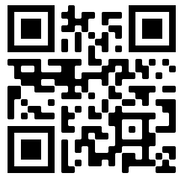
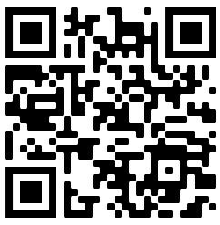
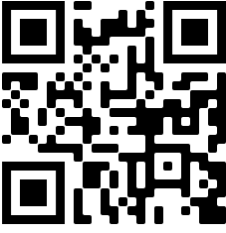
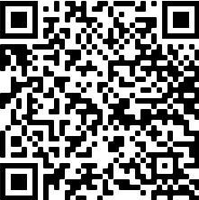
Study Tables and One-Pagers
Discord Server Link
One-Pagers Folder
https://discord.gg/eGxgyR6
https://rb.gy/z7l2ep

Slide 24
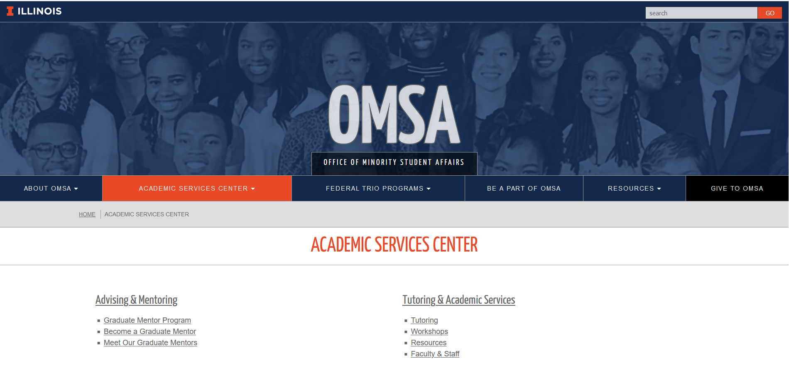
Office of Minority Student Affairs (OMSA)
https://omsa.illinois.edu/
Notes:
The office entrance is in the back of the building (just behind Merry Ann's Diner) and can be accessed from Oregon Street across from the Krannert Center for the Performing Arts.

Slide 25
CARE
https://care.engineering.illinois.edu/

Slide 26
Picture Time!

Slide 27
Questions?

Slide 28
Upcoming Events
Fun!
JEB Elections!
Sunday, Sept. 20th
Research Workshop
Thursday, Sept. 24th
Academic
NSBE Study Tables
Sunday’s and Tuesday’s 7-11pm
GBMs
Intro to Grad School
Thursday, Sept. 17th
Facebook
Monday, Sept. 21st
Pepsi
Tuesday, Sept. 22nd

Slide 29
Thank you!
Questions?

Slide 30
Sign-In
GSP Sign-In
Other Sign-In
https://forms.gle/cA6bazGoaKA7RtK99

