Slide 1
College 101
9/14/20

Slide 2
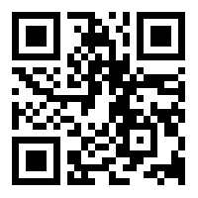
Sign In
Grainger Student Portal Sign-In
Other Sign-In
https://tinyurl.com/y69dfeon
Don’t have access to Grainger Student Portal?
Membership Form submissions will be used to add you on the platform in a couple of weeks.

Slide 3
Agenda
Page 5
Announcements
Page 7
Wellness (in the time of COVID)
Page 14
Study Skills and Time Management Activity
Page 18
Hidden Gems
Page 19
Ways to escape UIUC

Slide 4
Our Mission
To increase the number of culturally responsible Black engineers who
excel academically,
succeed professionally,
and positively impact the community.

Slide 5
Announcements

Slide 6
Welcome to College!

Slide 7
Wellness
the state of being in good health, especially as an actively pursued goal

Slide 8
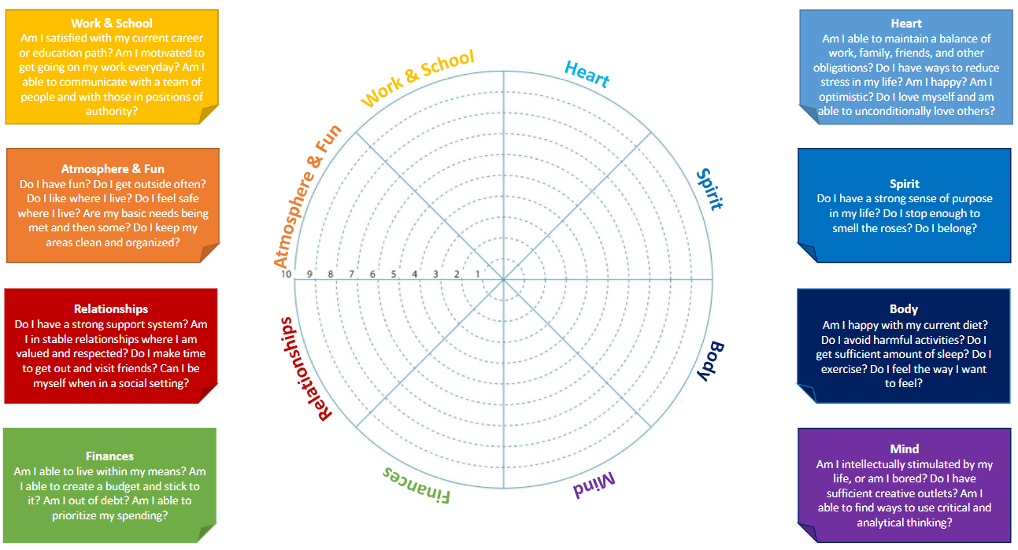
Wellness Wheel

Slide 9
How do we stay well?
Challenges
Resilience
Wellness

Slide 10
Wellness in the Time of COVID

Slide 11
UIUC Resources
Work & School
Engineering Career Services (ECS)
The Career Center
CARE Tutoring
Atmosphere & Fun
Illini Union Events
UIUC Event Calendar
Huge list of virtual events
Virtual cultural house events
Relationships
UIUC Counseling Center
Women’s Resource Center
Virtual events
Resident Advisors (RAs)

Slide 12
UIUC Resources
Finance
USFSCO
OSFA
Scholarships
Student Money Management Center
Virtual Job Board
Heart
UIUC Counseling Center
Cultural Houses
Resident Advisors (RAs)
Spirit
Volunteering
UIUC Counseling Center
Religious Organizations
Resident Advisors (RAs)

Slide 13
UIUC Resources
Body
Twice weekly COVID tests
Home workouts
McKinley Health Center
FREE flu vaccines start today!
Mind
UIUC Counseling Center
RSOs
Google Calendar (Balancing)
Stress Management Programs @ McKinley

Slide 14
Other Resources
https://www.psychologytoday.com/us/therapists
Enter your insurance
Some even take the university insurance
Find a therapist specific to your needs
Resources from the audience?

Slide 15
Study Skills &
Time Management

Slide 16
Studying Tips and Tricks
Office Hours
Study in Groups (depends on what you need)
Study Tables
Create your study guides
NSBE Buddies
SLEEP
Organize your day and block time for studying
Skills from the audience?

Slide 17
Time Management Activity
Scenario #1
Option C
Go to McKinley. Email your professors explaining your situation with a note.
Option A
Pull three all-nighters the moment you don’t have a fever so you can cram for all three exams.
Scenario #1
You get sick and miss all of your classes in one day. Three of your classes have midterms next week and the classes you missed were very useful review sessions! What do you do?
Option B
Look on your course websites to see if there are conflict exams that would give you more time.

Slide 18
Time Management Activity
Scenario #2
Option C
Fake illness. Get a note from McKinley so you don’t have to go to the competition and you get an extension on the project.
Option A
Organize your time so you can finish the project before the competition because you can’t let your team down or compromise your grades.
Scenario #2
Your RSO has an important competition/presentation coming up that you have to attend. You also have a big project due next week. How do you manage?
Option B
Let your team deal on their own at the competition. Focus only on your grades.

Slide 19
Hidden Gems
Illini Union Events
Virtual Book Club
Pocket Points
Mckinley Packs
Green Street Restaurants
Audience tips?
Residence Hall Libraries
Departmental Free Printing

Slide 20
Ways to Escape UIUC
Tennis Courts
Japan House/Koi Pond
Downtown Champaign
Parks
Audience tips?
Downtown Urbana
Social/Athletic RSO’s

Slide 21
Upcoming Events
Fun!
JEB Elections!
Sunday, Sept. 20th
Research Workshop
Thursday, Sept. 24th
Academic
NSBE Study Tables
Sunday’s and Tuesday’s 7-11pm
Preparing for Midterms w/ CARE
Wednesday, Sept. 16th
GBMs
Intro to Grad School
Thursday, Sept. 17th
Facebook
Monday, Sept. 21st
Pepsi
Tuesday, Sept. 22nd

Slide 22
Thank you for coming!

Slide 23
Sign In
Grainger Student Portal Sign-In
Other Sign-In
https://tinyurl.com/y69dfeon
Don’t have access to Grainger Student Portal?
Membership Form submissions will be used to add you on the platform in a couple of weeks.

