Slide 1
NSBE Buddies Kick-Off

Slide 2
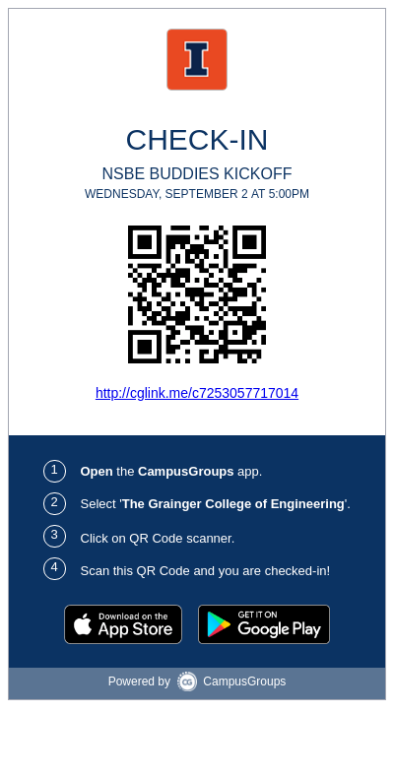

Slide 3
What is NSBE Buddies?
NSBE Buddies is a mentoring program that pairs underclassmen and transfer students with other students that have experience at UIUC
NSBE Buddies also connects you to other new students and is a great way to meet new people and make connections
Mentors will have weekly check-ups on buddies through text on different topics
Buddies and Mentors will attend monthly meetings to talk about more specific topics in depth

Slide 4
Why be a NSBE Buddy?
Get advice from people who were in your shoes not too long ago so you don’t make mistakes you don’t have to
Have someone you can rely on to answer your questions about school, social activities, or life in general at UIUC
Receive information about academics and career opportunities from guest speakers during meetings
Create a community of Buddies and Mentors that can help you even after your first semester

Slide 5
Time to meet your Mentors!

Slide 6
Introduce Yourselves
Everyone say their...
Name
Major
Year
Craziest thing that happened at your high school
Exchange contact information
Leave the breakout room when you are done

Slide 7
Kahoot Time
Work together as a team of mentors/buddies

Slide 8
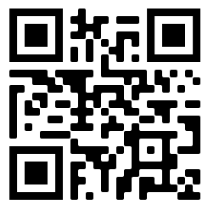
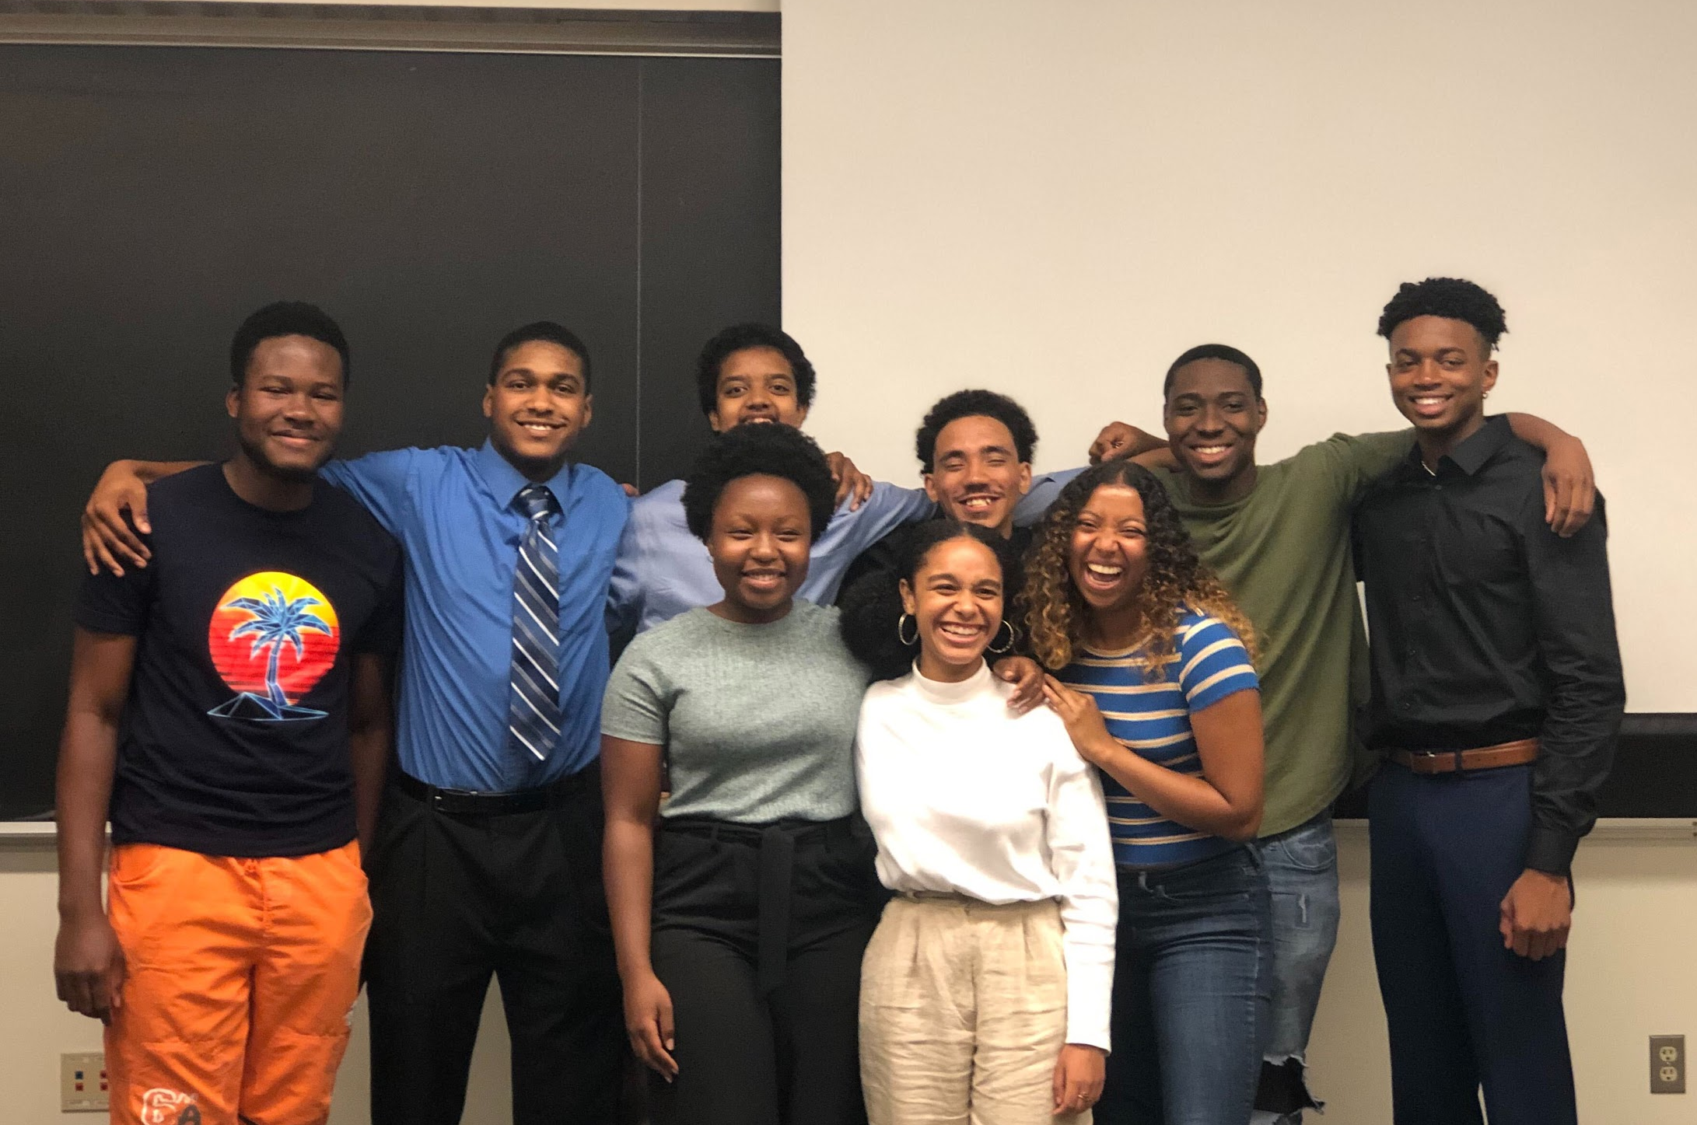
Fill out the interest form my scanning the QR code or going to the following link: https://bit.ly/2Efv8JU
Gain leadership experience, build a network, and refine your professional skills in a low-stress environment!
JEB Kickoff meeting: September 6th, 5-6pm, Zoom
nsbe.uiuc.vp@gmail.com

Slide 9
Thank You
Questions?

